Slide 1

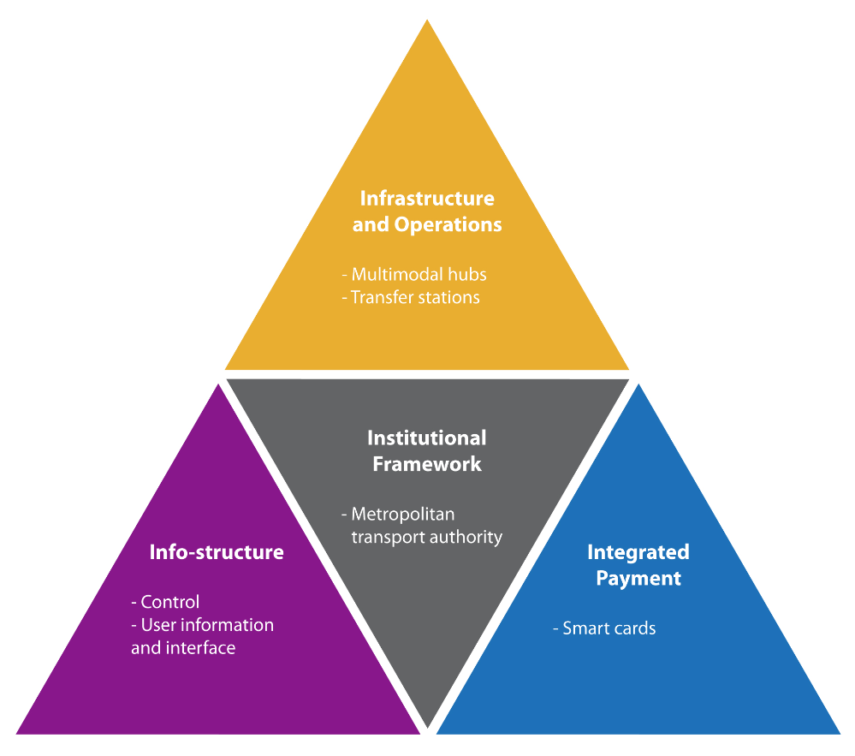
Go, change the world
RV College of
Engineering
DESIGN THINKING LABORATORY [18TE47]
Theme
Smart City Technologies
Multi-mode transportation
STUDENT NAME USN
CHINMAY M RAJU 1RV20ET016
CHIRAG C RAO 1RV20ET017
RISHAB RAO 1RV20ET043

Slide 2

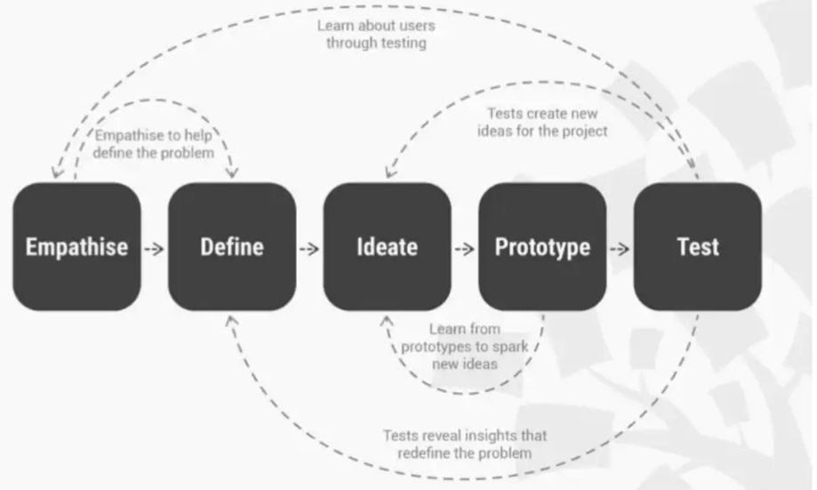
Go, change the world
RV College of
Engineering
THE DESIGN THINKING PROCESS

Slide 3
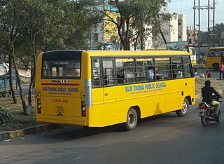
Go, change the world
RV College of
Engineering
MULTIMODE TRANSPORTATION
We have managed to ponder over the various problems faced by different stakeholders frequently.
Much needed topic of discussion
Problems from personal experience
Stories by close ones about problems

Slide 4

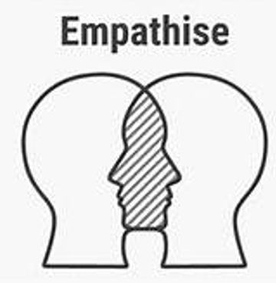
Go, change the world
RV College of
Engineering
EMPATHY PHASE
Stakeholder 1
STUDENTS
Students are the worst affected of all the stakeholders that are going to be discussed in the upcoming slides.
They face problems related to waiting time, delay due to negligence etc.

Slide 5
Go, change the world
WHAT ARE THE PROBLEMS YOU FACE WHILE USING YOUR CONCERNED MODE OF TRANSPORT?
WHAT IS YOUR PREFFERED MODE OF TRANSPORT (PUBLIC/ PRIVATE)?
DO YOU FEEL SAFE USING PRIVATE/PUBLIC MODE OF TRANSPORT?
Do you feel safe walking alone in the evening?
How much do you walk everyday?
Do you go somewhere else after you are dropped
How much do you pay for your mode of transport?
HAVE YOU EVER FACED ANY ISSUE DURING THE DURATION OF YOUR TRAVEL?
Have you faced any issue in locating a seat for the duration of your travel?
RV College of
Engineering
QUESTIONARE

Slide 6
Go, change the world
RV College of
Engineering
EMPATHY MAP
SAY
IT’S A HASSEL TO GO TO SCHOOL
THINK
IT WON’T BE A PROBLEM IF I GO HOME LATE
STUDENT
DO
GOING LATE BACK HOME
ROAMING AROUND
FEEL
DOESN’T FEEL SAFE /
FREEDOM FROM GUARDIAN

Slide 7
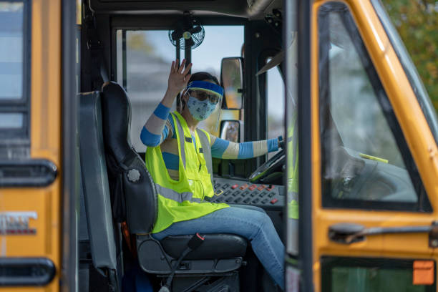
Go, change the world
RV College of
Engineering
EMPATHY PHASE
Stakeholder 2
The drivers / operators
Drivers often work overtime. This leads to fatigue and bad mental. Hence affecting their work and also their personal life.

Slide 8
Go, change the world
How long have you held this post for?
Are you familiar with the children and their bus routes ?
Have you ever faced any issue during your daily route? If yes, then what are the problems?
How many students do you drop/pick up everyday?
Have you ever been penalized for any wrong doings?
Has any student asked you to drop you closer to his/her house?
On an average how long does your trip last?
How many students do you drop in a particular trip?
Usually how do the students go home from the drop location?
Do you wait for the student to reach home before taking off?
Do you feel exhausted by the end of the day?
Do you feel you over work?
How do students behave in the bus/van?
RV College of
Engineering
EMPATHY PHASE
QUESTIONARE

Slide 9
Go, change the world
RV College of
Engineering
EMPATHY MAP
SAY
THE PARENTS HAVE TO MAKE THE NECESSARY ARRANGEMENTS
THINK
IT’S NOT MY JOB TO DROP THEM TILL THEIR DOOR
DRIVER/
OPERATOR
DO
DROP THE WARD AT A CONVINIENT LOCATION FOR HIM/HER
FEEL
THIS IS THE MOST THAT CAN BE DONE FROM MY SIDE

Slide 10

Go, change the world
Stake Holder
PARENTS/GUARDIANS
Usually ,either one or both parents are working
from their workspace or their homes ,
making it difficult to attend in changes
in their daily schedule
RV College of
Engineering
EMPATHY PHASE

Slide 11
Go, change the world
WHAT ARE YOUR MAIN CONCERNS WHEN IT COME TO THE SAFETY OF YOUR CHILDREN?
DO YOU FEEL COMFORTABLE/SAFE SENDING YOUR CHILDREN ALONE BY PUBLIC/PRIVATE TRANSPORT ?
WHAT ARE YOUR CONCERNS ABOUT IT ?
ARE YOU WILLING TO CHANGE THE SYSTEM?
ARE YOU AWARE OF THE ROUTE YOUR CHILDS TRANSPORT SYSTEM USES?
ARE YOU AWARE OF THE TIMING SCHEDULE USED BY YOUR CHILDS TRANSPORT SYSTEM?
HAVE YOU EVER CONSIDERED ANY OTHER ALTERNATIVE TRANSPORT FOR YOUR WARD?
HOW MUCH DO YOU PAY FOR THE TRANSPORTATION SERVICE?
DO YOU FEEL CONCERENED IF YOUR WARD ARRIVES LATE?
WHAT DO YOU THINK IS THE BEST MODE OF TRANSPORTATION FOR WARD WITHOUT TAKING THE PRICE INTO CONSIDERATION?
IS THE SCHOOL TRANSPORT MORE EXPENSIVE THAN PRIVATE VAN/ PUBLIC TRANSPORT?
RV College of
Engineering
QUESTIONARE

Slide 12
Go, change the world
RV College of
Engineering
EMPATHY MAP
SAY
THERE’S NO ONE TO TAKE CARE OF MY KIDS
THINK
WHY CAN’T THE SCHOOL MANAGEMENT LOOK AFTER THIS
PARENT
DO
CONSTANTLY CALLING TO CHECK WHETHER MY CHILDREN ARE HOME
FEEL
LACK OF SAFETY FOR OUR CHILDREN

